Slide 1
CIS 490H/590J Edge Computing
Privacy and Security
Winter 2022
Prof. Zheng Song
zhesong@umich.edu

Slide 2
Cloud Security and Privacy
Most security problems stem from:
Loss of control
Your data is in the cloud
Your application is hosted by the cloud
Multi-tenancy
Multiple independent users share the same physical infrastructure
Thus an attacker can legitimately be in the same physical machine as the target

Slide 3
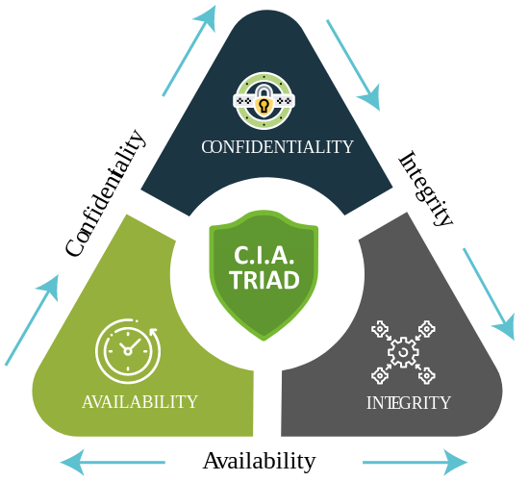
Cloud Security and Privacy (in security terms)
Confidentiality:
Will cloud compromises leak confidential client data?
Will cloud provider itself be honest and won’t peek into the data?
Integrity:
How do I know the cloud provider is doing the computations correctly?
How do I ensure that the cloud provider really stored my data without modifications
Availability:
Will my application go down if the provider is attached?
What happens if cloud providers goes out of business?

Slide 4
Additional Risks for Cloud Computing
Privacy issues raised by massive data mining:
Cloud now stores data from a lot of clients, and can run data mining algorithms to get large amount of information on clients;
Increased attack surface:
Attackers can now target the communication link between cloud providers and clients.

Slide 5
Threat Model
A threat model helps in analyzing a security problem, design mitigation strategies, and evaluate solutions
Steps:
Identify attackers, threats and other components
Rank the threats
Choose mitigation strategies
Build solutions based on the strategies

Slide 6
Attacker: Malicious Insiders
At Cloud Provider
Log client communication
Can read unencrypted data
Can possibly peek into VMs, or make copies of VMs
Can monitor network communication, application patterns
Why?
Gain information about client data
Gain information on client behavior
Sell the information or use itself

Slide 7
Attacker: Outside attacker
What?
Listen to network traffic (passive)
Insert malicious traffic (active)
Probe cloud structure (active)
Launch DoS
Challenges:
How to find out where the target is located?
How to be co-located with the target in the same (physical) machine?

Slide 8
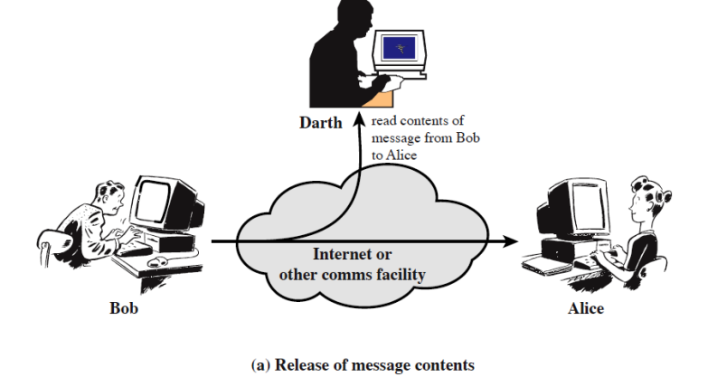
Passive Attack (1) Eavesdrop

Slide 9
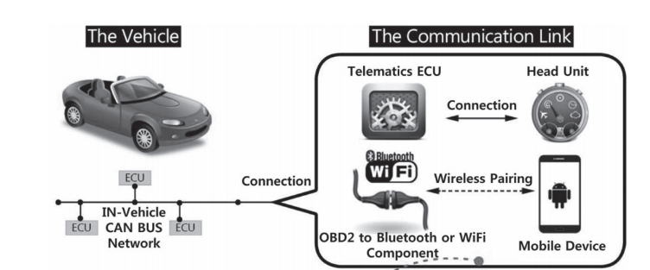
Passive Attack (1) Eavesdrop
No longer popular, as most data going through the Internet are encrypted!
Some IoT system may still suffer

Slide 10
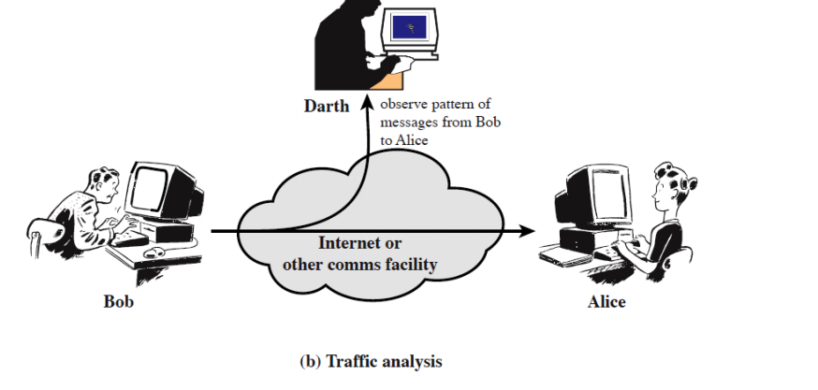
Passive Attack (2) Traffic Analysis
Even for encrypted data!

Slide 11
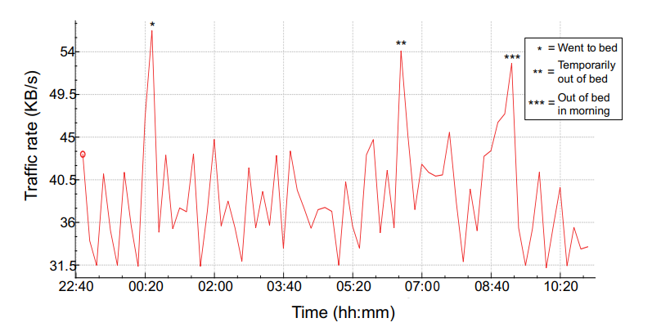
Traffic Analysis Example
“Spying on the smart home: Privacy attacks and defenses on encrypted IoT traffic”
Notes:
Research from Princeton, published in year 2017,

Slide 12
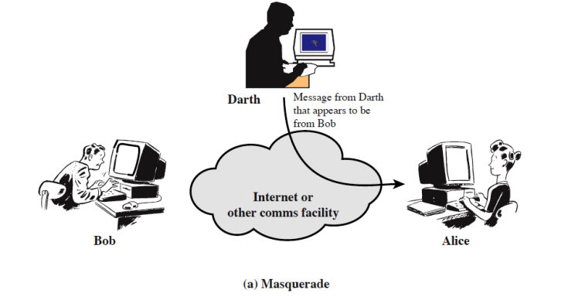
Active attack (1) - spoofing

Slide 13
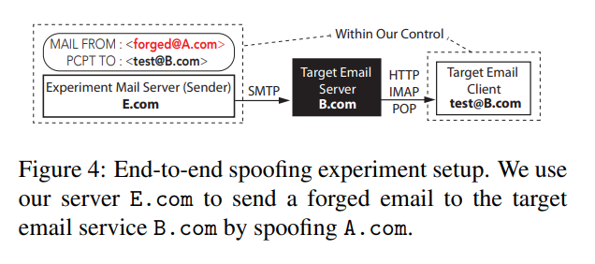
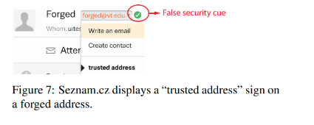
Email Spoofing Attack
End-to-End Measurements of Email Spoofing Attacks, UsenixSecurity’18
Conclusion: We demonstrate that most email providers allow forged emails to get to user inbox, while lacking the necessary warning mechanism to notify users (particularly on mobile apps).

Slide 14
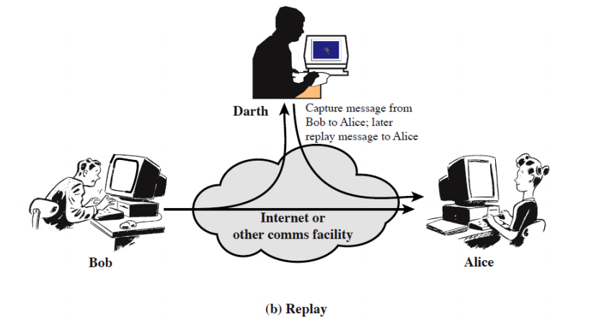
Active (2) - replay

Slide 15
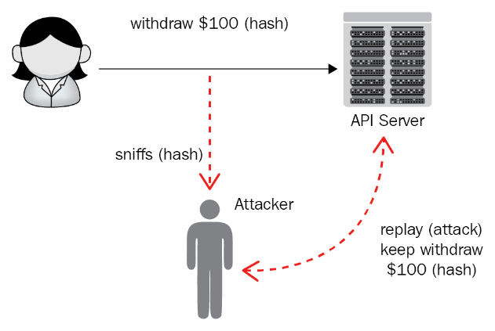
Replay Attacks
Usually integrated with Sniffing (eavesdropping )
Notes:
The legitimate user sends a valid request, but the attacker spoofs it and resends/replays it to the APIs.
As RESTful APIs are stateless, the attacker can keep withdraw caches.
How to prevent replay attacks？Add some randomness for each communication. For example, add a timestamp for each withdraw, or use a password for each transaction that’s only used once and discarded.

Slide 16
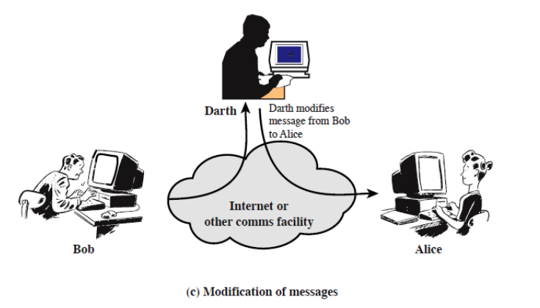
Active (3) – intercept & modify
Man in the middle attack!

Slide 17
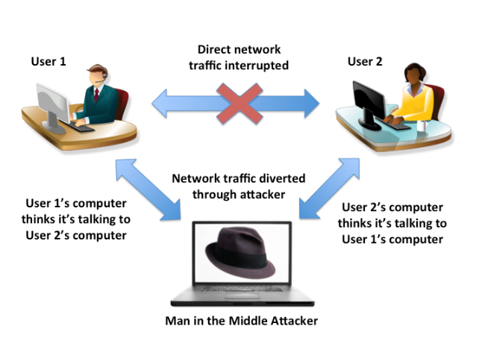
Man in the Middle Attack
Attacker pretends to be the sender/receiver

Slide 18
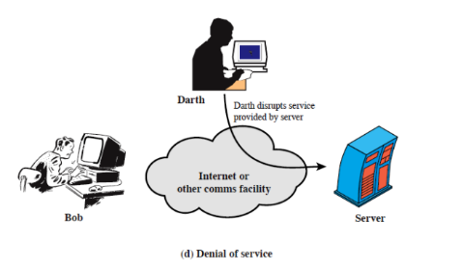
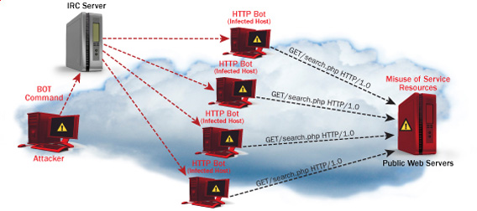
Active (4) - DoS
Notes:
Amazon Web Services (AWS) reports that in February 2020, they defended against a 2.3 -terabit-per-second (Tbps) distributed denial of service (DDoS) attack!
In Q1 2020, a known UDP reflection vector, CLDAP reflection, was observed with a previously unseen volume of 2.3 Tbps. This is approximately 44% larger than any network volumetric event previously detected on AWS. CLDAP reflection attacks of this magnitude caused 3 days of elevated threat during a single week in February 2020 before subsiding. Despite this observation, smaller network volumetric events are far more common. The 99th percentile event in Q1 2020 was 43 Gbps.”

Slide 19
Cloud → Edge
Confidentiality:
Will Edge compromises leak confidential client data?
Will Edge provider itself be honest and won’t peek into the data?
Integrity:
How do I know the Edge provider is doing the computations correctly?
How do I ensure that the Edge provider really stored my data without modifications
Availability:
Will my application go down if the provider is attached?
What happens if Edge providers goes out of business?

Slide 20
Additional risks for Edge Computing
1) Higher Risk:
Private Edges (outpost): more privacy-sensitive data are stored
Closer to the end users: easier to identify data owners
edge nodes have limited resources and higher latency requirements, so they cannot support complex security mechanisms
2) More participants and system variants:
Increased attack surface
No one-size-fit-all solution

Slide 21
Solutions
Trusted Execution Environment: Service Provisioning in untrusted environments
Blockchain (Distributed Ledger): how to reach an agreement on the same value in the presence of a number of faulty processes?

Slide 22


Trust Issues: Provider Perspective
Cloud/Edge provider does not trust users
Use virtual machines to isolate users from each other and the host
VMs only provide one way protection
Redis
OS
VMM
Firmware
trusted
Cloud platform
Staff
…

Slide 23
Trust Issues: User Perspective
Users trust their applications
Users must implicitly trust cloud provider
Existing applications implicitly assume trusted operating system
Redis
OS
VMM
Firmware
untrusted
Cloud platform
Staff
…

Slide 24




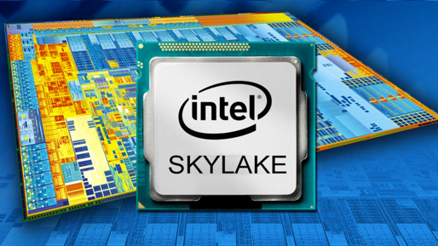
Trusted Execution Support with Intel SGX
Users create HW-enforced trusted environment (enclave)
Protects against strong attacker model
Available on commodity CPUs
Enclave
OS
VMM
Firmware
untrusted
Cloud platform
Staff
…

Slide 25
Trusted Execution Environments
Trusted execution environment (TEE) in process
Own code & data
Controlled entry points
Provides confidentiality & integrity
Supports multiple threads
Full access to application memory
User process
OS
Enclave
Enclave code
Enclave
Enclave data
Application code
Threads
…
Protects confidentiality and integrity of code & data in untrusted environments
Platform owner considered malicious
Only CPU chip and isolated region trusted
Application data

Slide 26
SGX SDK Code Sample
SGX application: untrusted code
char request_buf[BUFFER_SIZE];
char response_buf[BUFFER_SIZE];
int main()
{ ...
while(1)
{ receive(request_buf); ret = EENTER(request_buf, response_buf); if (ret < 0)
fprintf(stderr, "Corrupted message\n");
else
send(response_buf); } ... }
Enclave: trusted code
char input_buf[BUFFER_SIZE];
char output_buf[BUFFER_SIZE];
int process_request(char *in, char *out)
{
copy_msg(in, input_buf); if(verify_MAC(input_buf))
{
decrypt_msg(input_buf); process_msg(input_buf, output_buf);
encrypt_msg(output_buf);
copy_msg(output_buf, out); EEXIT(0); } else EEXIT(-1); }
Server:
Receives encrypted requests
Processes them in enclave
Sends encrypted responses

Slide 27
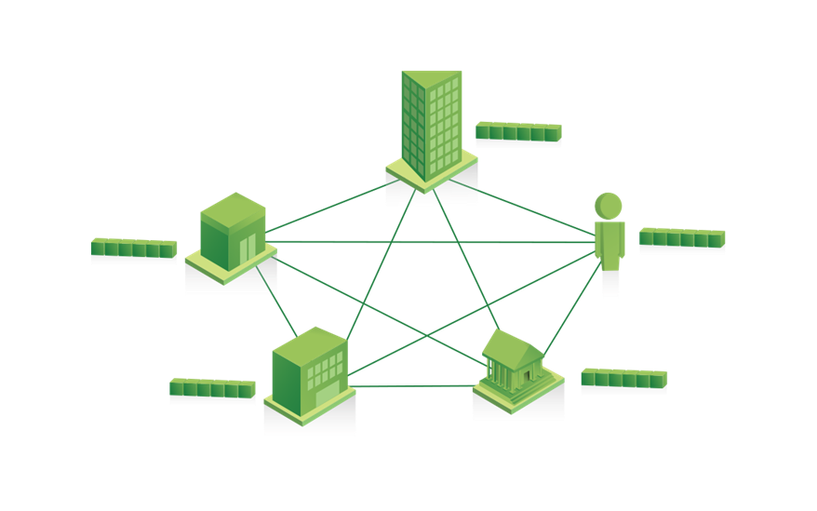
Distributed Ledger Technology
•Distributed database – you can insert, select data, but can’t update or delete data

Slide 28
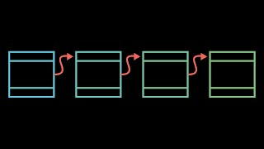
BlockChain

Slide 29
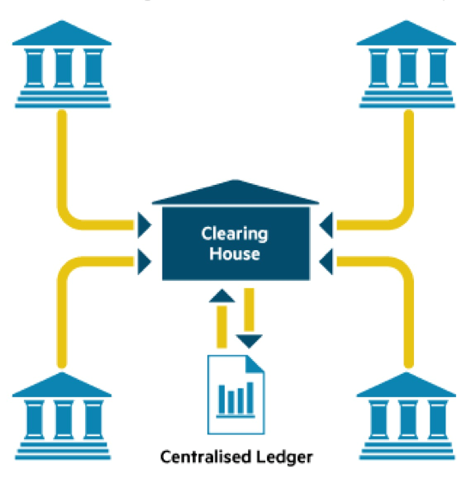
Centralized Ledger
Context: How to exchange assets safely between two parties?
Centralized Ledger:
An account book that records all transactions
Controlled by a trusted central authority
E.g. a clearing house / Bank
Problem:
Single point of failure
Long response time

Slide 30
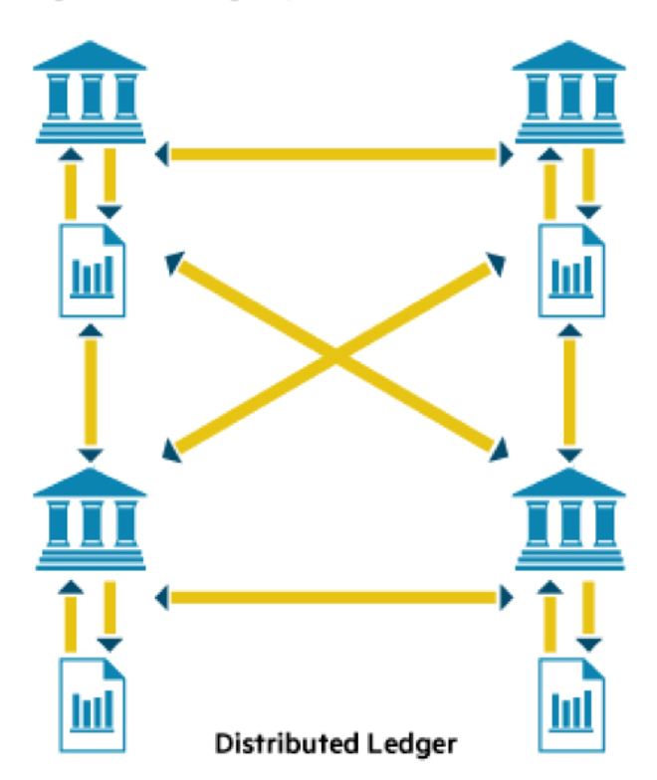
Distributed ledger
Shared by participants: replicated
Decentralized
Append-only: no update, no delete
Distributed Transaction validation: consensus
Verifiable
Notes:
Byzentine general theory: you must have at least 2/3 of the nodes in a network to be trustworthy, otherwise, malicious nodes will successfully confuse the network/distributed system.

Slide 31
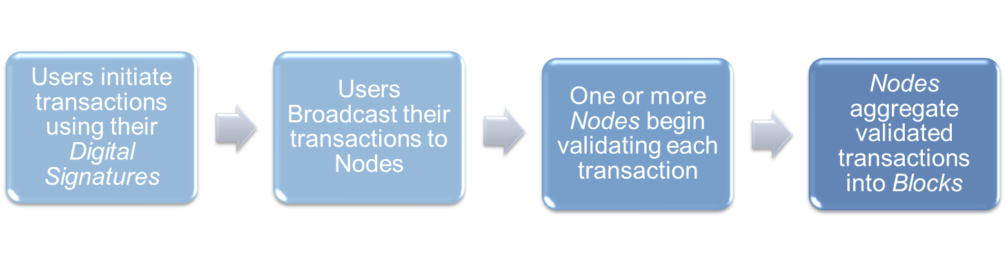
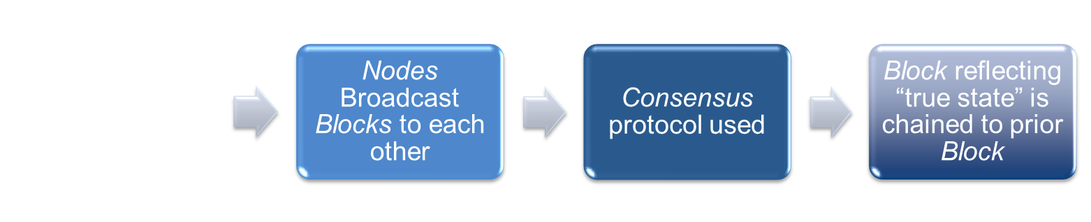
Distributed ledger – How it works?
Notes:
oExplain how the distributed ledger works (from users to nodes until the block is validated and added into the chain).
Source: “A brief introduction to blockchain”, Nancy LIAO, 2005

Slide 32
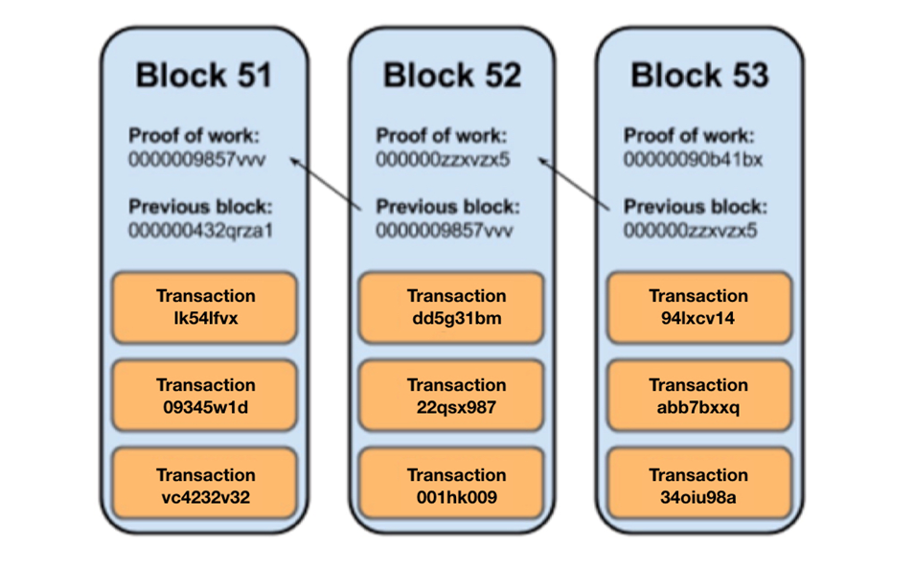
Transaction & blocks
A transaction is a value transfer;
A block is a collection of transactions on the bitcoin network, gathered into a block that are hashed and added to the blockchain.

Slide 33
Consensus
Critical applications: transaction validation, identity verification, etc.
Major problem of distributed systems
Problem statement: given n processes and one leader, how to reach:
Agreement : all correct processes agree on the same value
Validity: if initiator does not fail, all correct processes agree on its value
Types of failures:
Crash: the easy case
Malicious(also called Byzantine)

Slide 34
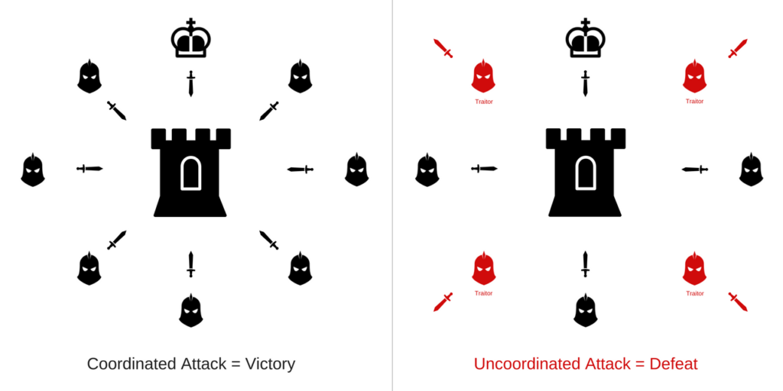
The Byzantine Generals Problem
Generals can only communicate by messengers and must establish a common plan to attack the enemy or retreat
Find an algorithm (consensus) to ensure that loyal generals can agree on a common battle plan
resist to n% malicious nodes
how to make sure less than n% malicious nodes? → increase cost

Slide 35
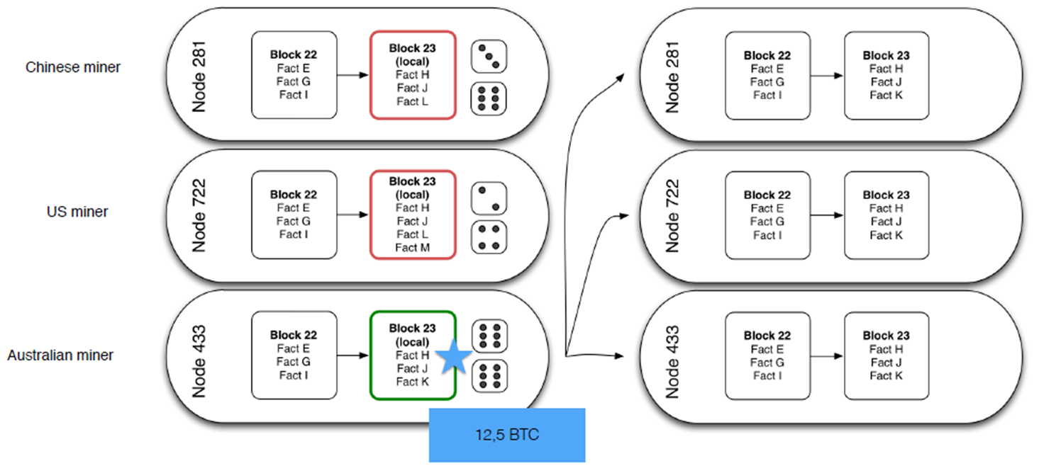
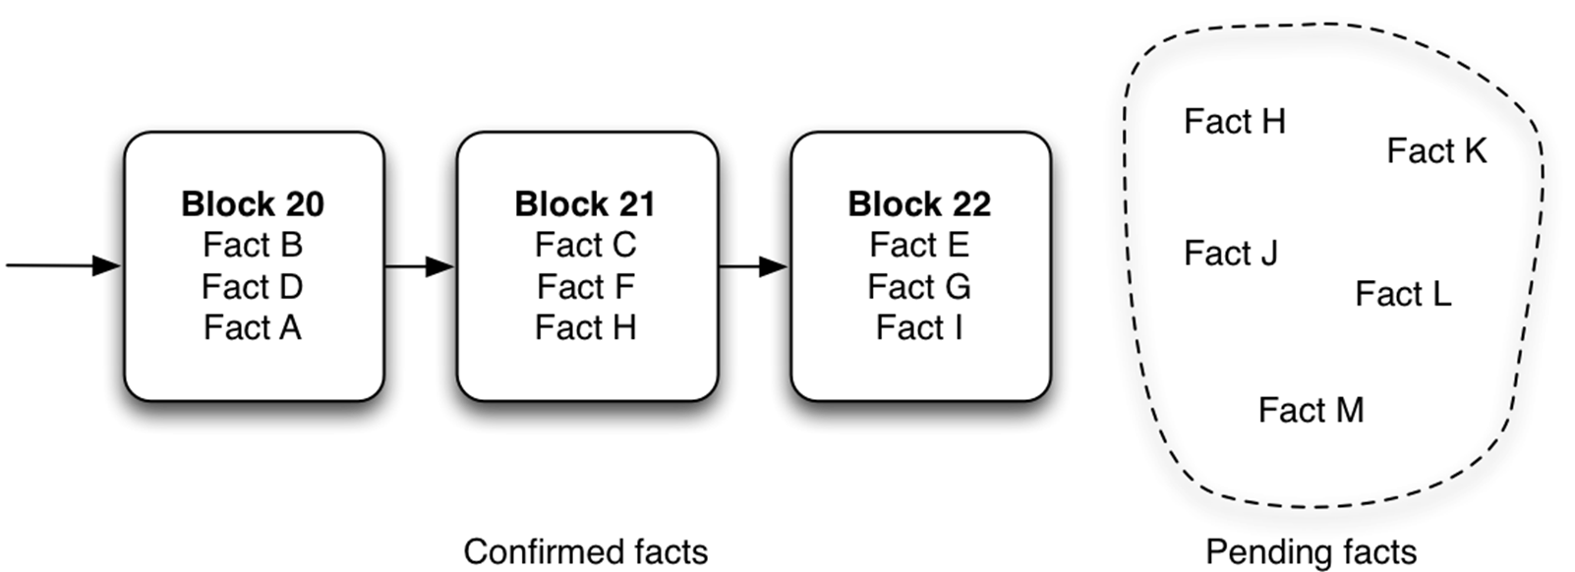
Proof of Work
Mining: solve a hard problem (hard to calculate, easy to validate)
triggers the release of cryptocurrencies.

Slide 36
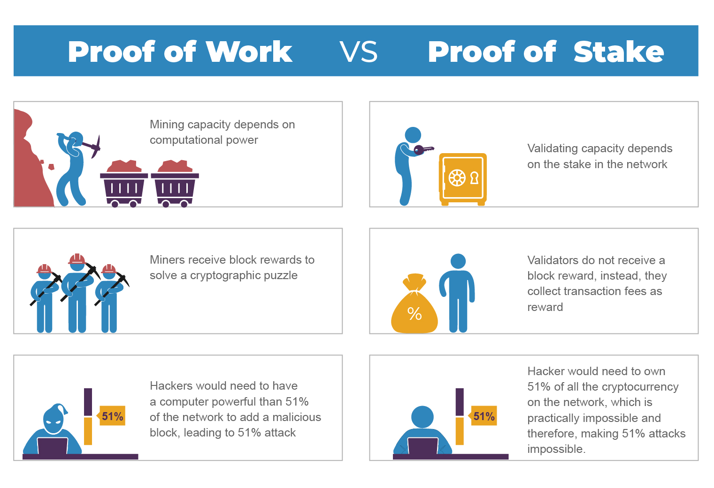
Proof of Shake

Slide 37
Practical Byzantine fault tolerant Mechanism
A three-phase protocol [Castro & Liskov 2002, MSR & MIT]
1. Pre-prepare: a leader broadcasts a value to be committed by other nodes
2. Prepare: the nodes broadcast the values they are about to commit
3. Commit: confirms the committed value when more than 1 - n% of the nodes agree in the previous phase

